Slide 1
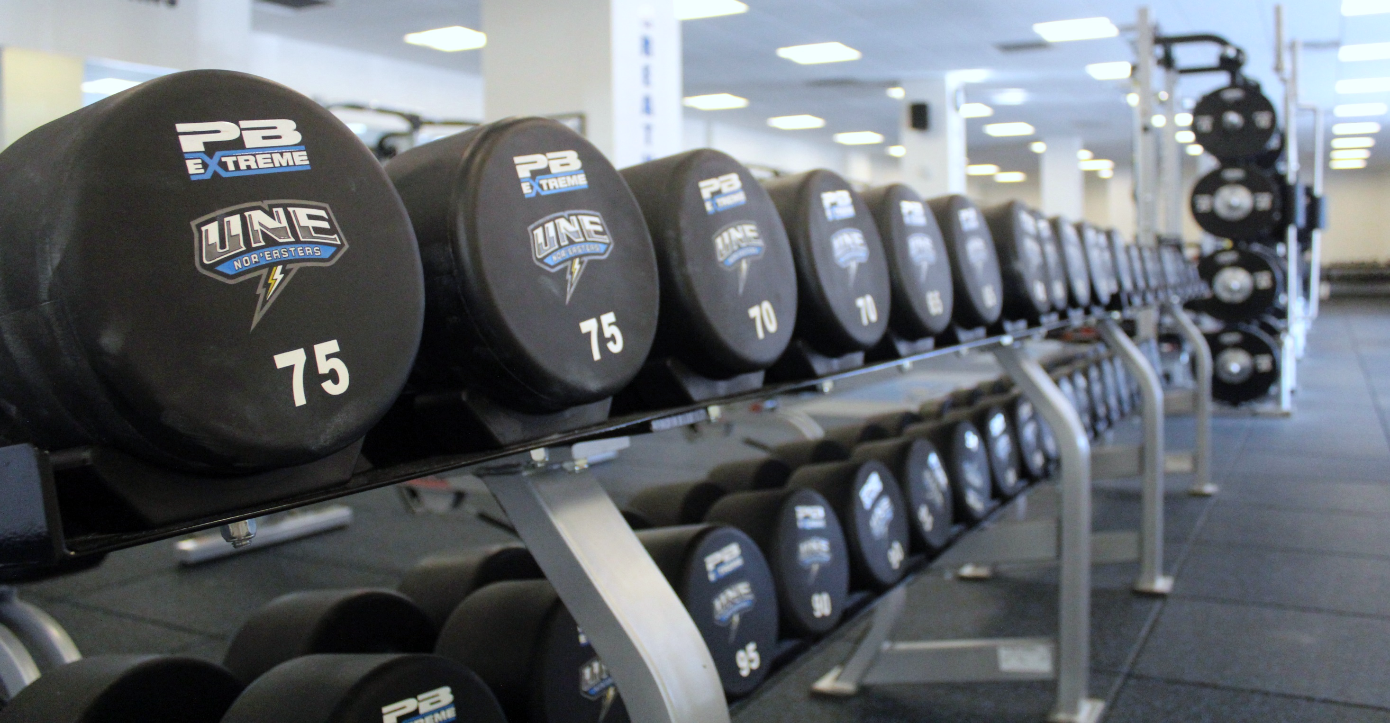
WINNING THE “WEIGHT”
STRENGTH TRAINING TO INCREASE PERFORMANCE & REDUCE INJURY AT HOME
Lyndie Kelley, RSCC, CSCS*D, NSCA-CPT, FMS-C, USA-W L1 – Coordinator of Strength & Conditioning

Slide 2
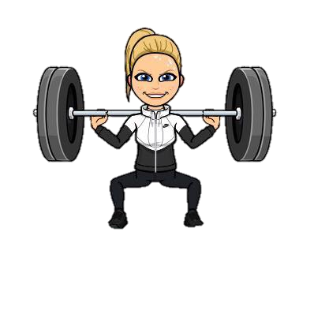
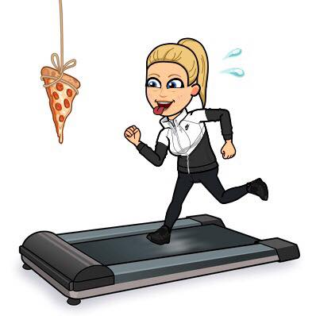
THANK YOU FOR BEING HERE!

Slide 3
WALKING THE WALK

Slide 4
WHAT’S ON OUR RADAR TODAY?
Quick Review of Athlete Anatomy
Benefits of Strength Training
Overcoming Barriers to Strength Training
Quick Movement Assessments
Designing a Strength Program

Slide 5
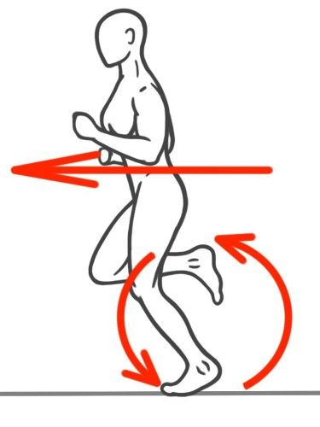
THE ANATOMY OF AN ATHLETE
Core = STABILIZATION, BREATHING, ENERGY TRANSFER…
Shoulder Girdle = RECIPROCAL MOTION
Upper Body = ENERGY CREATION
Hip Flexors = KNEE DRIVE
Glutes = HIP EXTENSION
Quadriceps = PUSH
Hamstrings = PULL/PELVIC STABILITY
Gastrocnemius + Soleus = PROPULSION

Slide 6
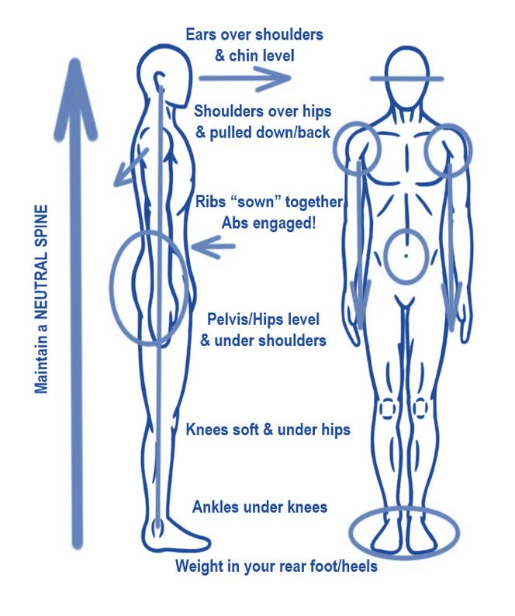
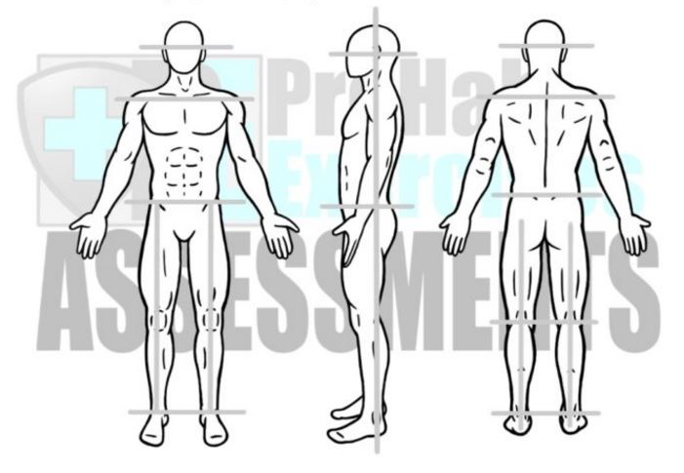
STACK UP FOR SUCCESS
SAGITTAL FRONTAL TRANSVERSE
COG

Slide 7
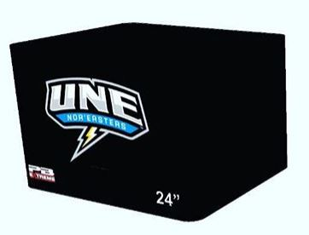
COACH K’S SOAP BOX
MOVEMENT QUALITY + STRENGTH =
HEALTHY, HIGH-PERFORMING ATHLETES
If you OWN a movement pattern and you GAIN strength to support it, you will PLAY/RUN efficiently and safely!
TRY not to lay dysfunction on top of poor movement mechanics…it becomes a self-fulfilling prophecy.
Incorporate ASSESSMENT of movement quality into your plan for the best individual results

Slide 8
LEVERAGING THE WEIGHT ROOM
Strength Training is an excellent way to improve
every facet of your performance…
Prevent over-use/repetitive stress injuries related to running
Improve energy use and neuromuscular efficiency
Boost bone density, cardiovascular and mental health
Increase overall muscular endurance and fitness
Clear up nagging injuries

Slide 9
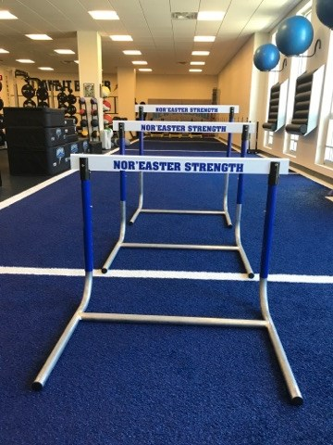
LIFTING BARRIERS TO, WELL…LIFTING
Let’s debunk some common misconceptions about Strength Training & Running…
“Running/walking is enough of a workout for my legs”
“I already have an injury”
“I don’t have enough time/access to a gym”
“I have no idea what exercises I should be doing”

Slide 10
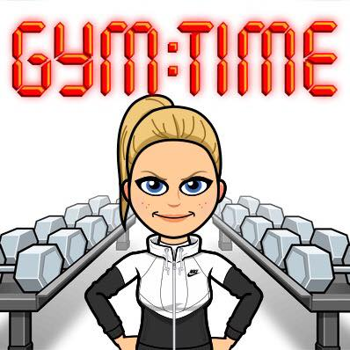
DO SIMPLE THINGS SAVAGELY WELL
Getting started with strength training can be daunting, but with the right tools and right mindset, it can be simple!
Dedicate 30-45 minutes for 2-3 x/wk
See every day objects as equipment
Train your whole body – not segments
Attack NEEDS before WANTS - Assessment
Be consistent with a program
Never underestimate SIMPLICITY

Slide 11
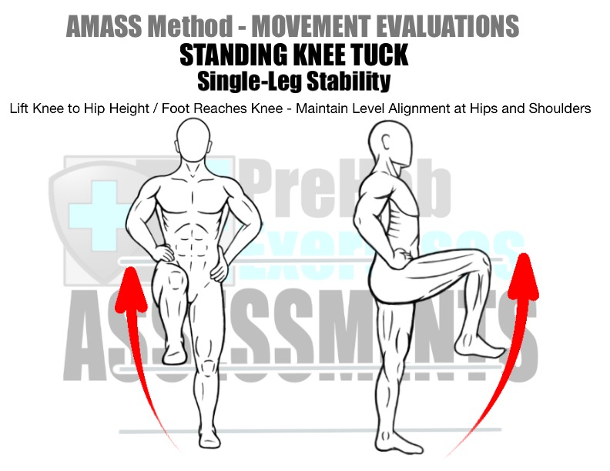
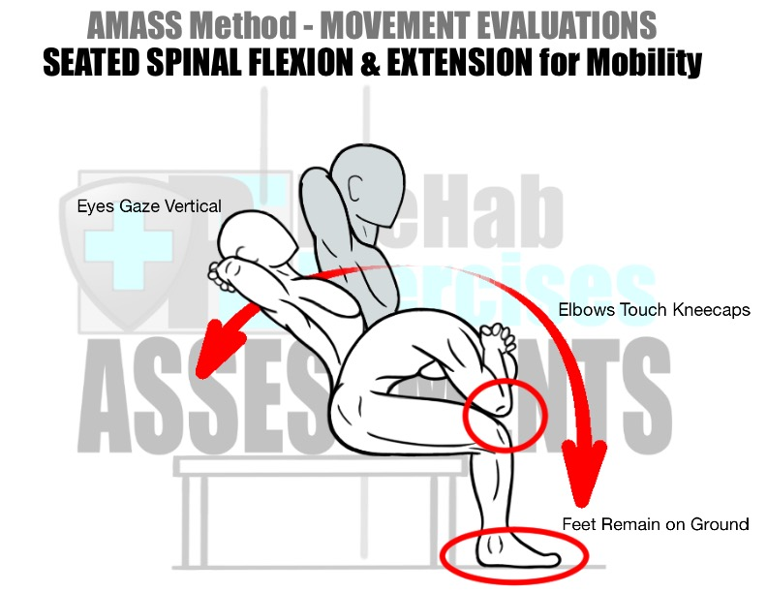
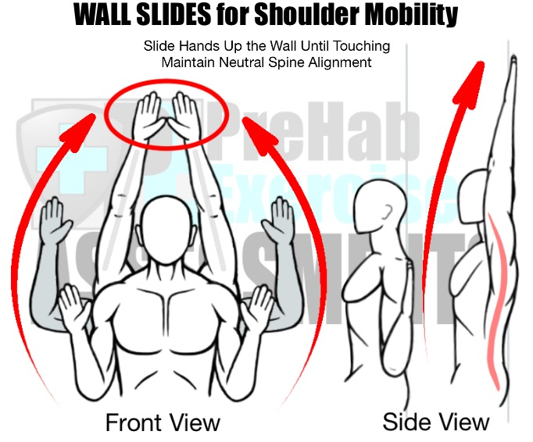
KNOW YOUR BODY!
These quick, self-assessments can provide you with valuable insight to your mobility/strength needs to improve your performance and
reduce the risk of injury!

Slide 12
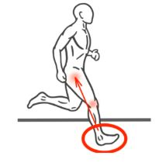
CONTROLLING THE CONTROLLABLES
Competitive sport creates tremendous forces that our musculoskeletal system must CONTROL.
Building strength can help you better withstand the ground-reaction forces experienced during training and racing…
Move MINDFULLY through phases of lifts
Incorporate ECCENTRIC & ISOMETRICS
Train in all 3 PLANES OF MOTION
Fuel your body for your energy expenditure

Slide 13
STEP UP TO THE STARTING LINE
Gaining education on the topic is a great start!
Any great strength program should include the following components…
Warm Up – address soft tissue quality, joint mobility/stability, increase core temperature and activate the neuromuscular system (R.AM.P. System)
Strength Work – include major muscle groups, the core and be 3-D minded.
It should be designed with muscular balance and desired goal in mind…
3 sets of 6-8 repetitions of 6-8 supersetted exercises is a good place to begin.
Cool Down – incorporate flexibility, mental rehearsal/visualization

Slide 14
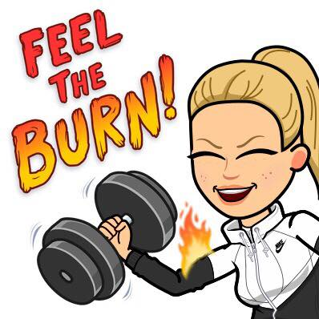
DESIGN YOURSELF STRONG
Let’s build your own strength training program!
Identify what equipment you have at home or what you can repurpose!
Pick 3-5 mobility/stability drills for your warm up!
Build your program to reflect muscular balance:
- Upper Body Pull + Lower Body Push
- Upper Body Push + Lower Body Pull
- Anti-Flexion/Extension + Anti-Rotation

Slide 15
COACH K’S TOP 6 @ HOME EXERCISES
Here are my go-to exercises for building strong athletes…
UPPER BODY PULL: Rows – Shoulder/Core Stability and Upper Back Strength
ANTI-ROTATION: Bird Dogs/Deadbugs – Stance Leg Stabilization and Core Control
LOWER BODY PRESS: Goblet Squats – Quadriceps, Glute and Anterior Core Activation
LOCOMOTION: Farmer Carry – Lateral Core Activation
UPPER BODY PUSH: Push Up Variations – Neutral Spine and Pelvic Stabilization
LOWER BODY PULL: Romanian Deadlifts – Hamstrings and Posterior Chain Activation

Slide 16
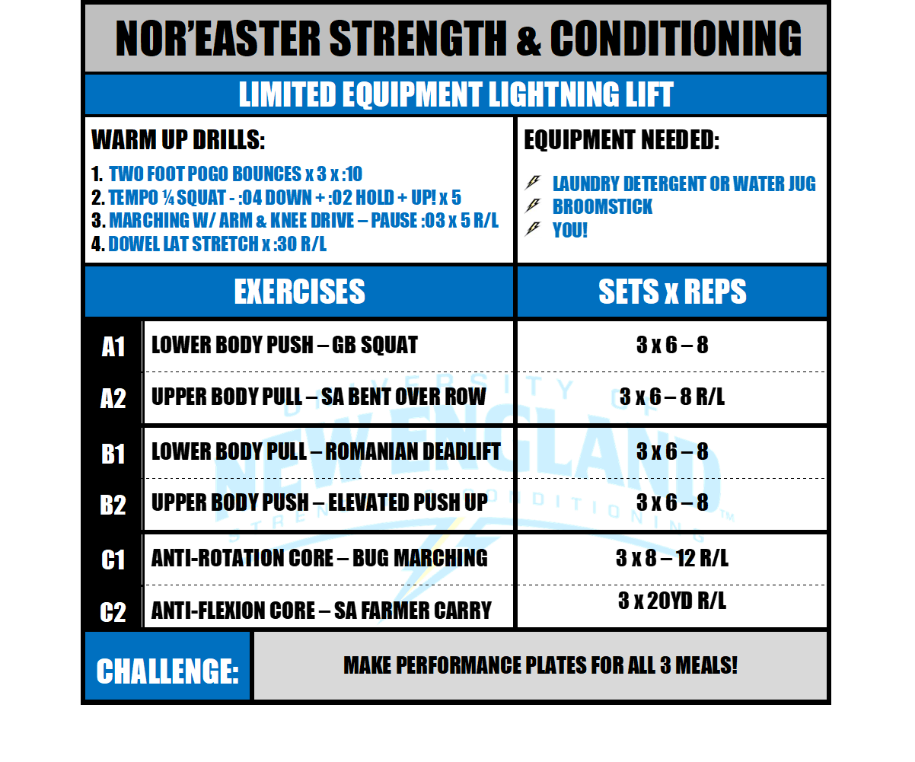
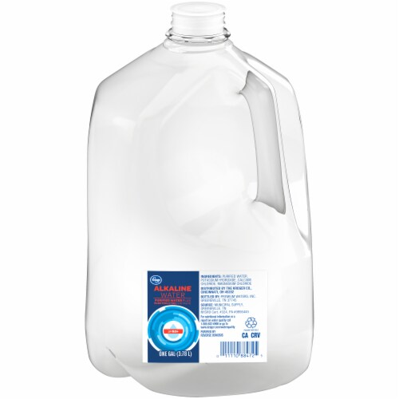

Slide 17
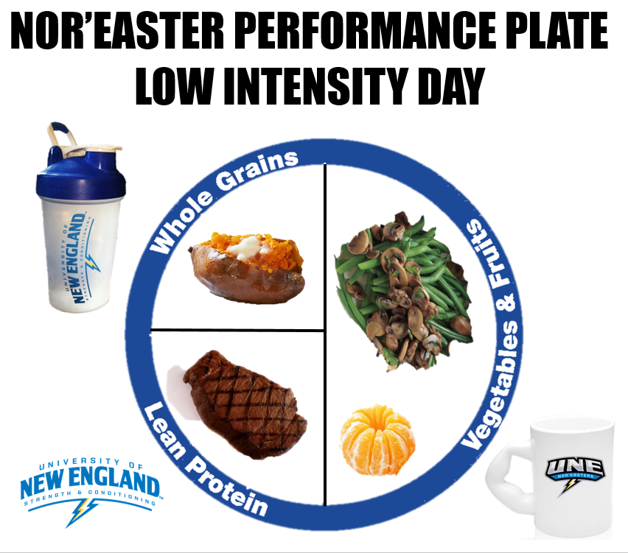

Slide 18
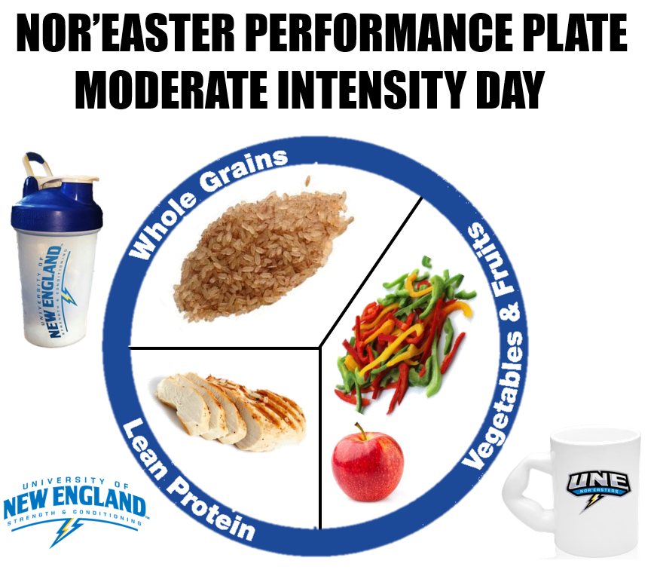

Slide 19
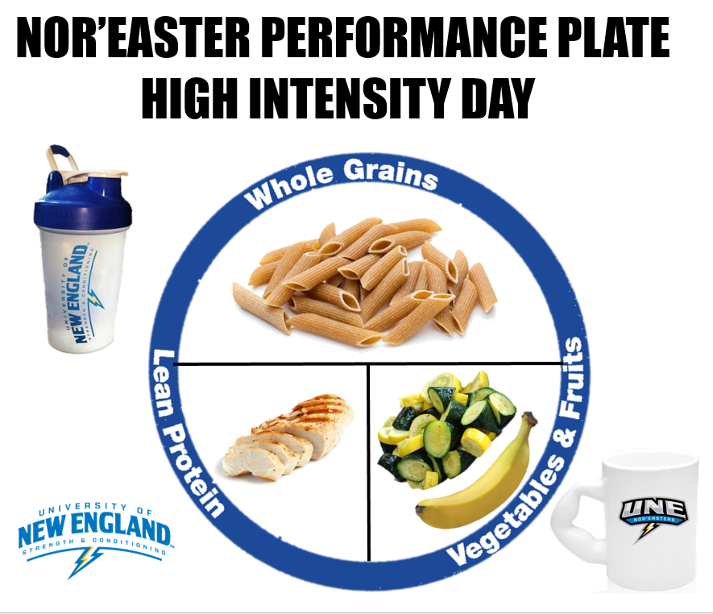

Slide 20
NOR’EASTER STRENGTH & CONDITIONING ATHLETE RESOURCES
noreaster_strength
Nor’easter Strength & Conditioning

Slide 21
MAKE YOUR HOME YOUR GYM!
Email: llibby2@une.edu

